Slide 1
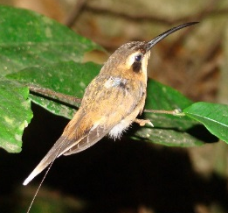
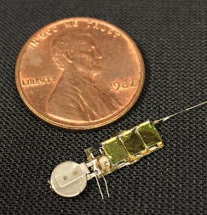
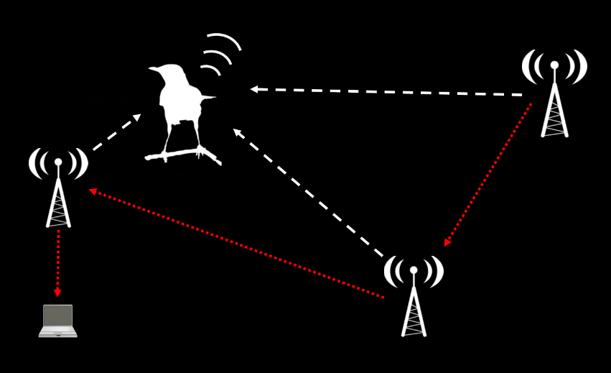
AMRUPT (Animal Movement Research Using Phase-based Trilateration)

Slide 2
This week
What did/did not work last semester?
GitHub / Blackboard organization
Proposal preparation
What is the plan for working on the proposal? Who does what? How will you coordinate?
What is the scope of the problem for Spring 2018?
What relevant resources have you found?
Brainstorm multiple solutions
Which solutions might be best?

Slide 3
Fall 2018 AMRUPT: What worked? What did not?

Slide 4
This week
What did/did not work last semester?
GitHub / Blackboard organization
Proposal preparation
What is the plan for working on the proposal? Who does what? How will you coordinate?
What is the scope of the problem for Spring 2018?
What relevant resources have you found?
Brainstorm multiple solutions
Which solutions might be best?

Slide 5
GitHub AMRUPT repository
Code: a place to store all materials
Course materials: assignments, instructions, management plan
Firmware: all code, organized by general purpose

Slide 6
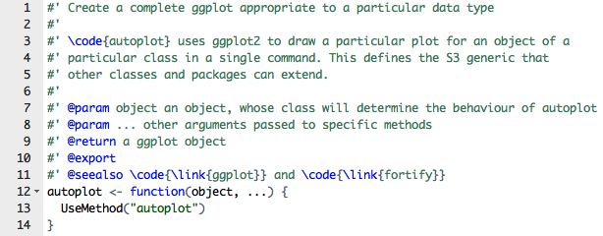
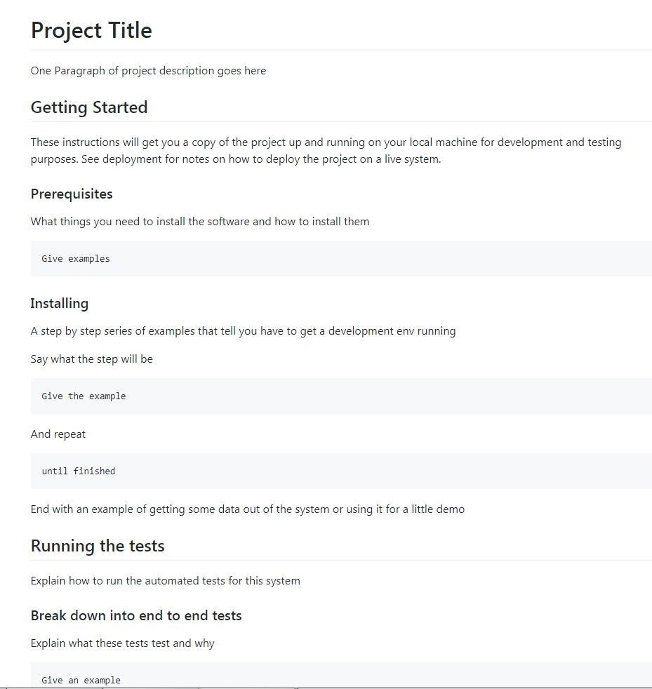
Good documentation is essential!
In-line comments
“ReadMe”file

Slide 7
GitHub AMRUPT repository
Code: a place to store all materials
Course materials: assignments, instructions, management plan
Firmware: all code, organized by general purpose
Literature: resources from others
System architecture: high-level diagram of current architecture
Tests: empirical test results, simulation files and results
Issues: a list of all of the known goals of the project
Special types: Questions, Enhancements
Milestones: Phases of the project
Project: a tool for management of progress
Columns: To do, In progress, In testing, Completed
Ordered list of current issues, and their status

Slide 8
This week
What did/did not work last semester?
GitHub / Blackboard organization
Proposal preparation
What is the plan for working on the proposal? Who does what? How will you coordinate?
What is the scope of the problem for Spring 2018?
What relevant resources have you found?
Brainstorm multiple solutions
Which solutions might be best?

Slide 9
Proposal prep: Who does what? How will you coordinate?
Define the AMRUPT Problem
Project Proposal
Khandani, 2005

Slide 10
This week
What did/did not work last semester?
GitHub / Blackboard organization
Proposal preparation
What is the plan for working on the proposal? Who does what? How will you coordinate?
What is the scope of the problem for Spring 2018?
What relevant resources have you found?
Brainstorm multiple solutions
Which solutions might be best?

Slide 11
This week
What did/did not work last semester?
GitHub / Blackboard organization
Proposal preparation
What is the plan for working on the proposal? Who does what? How will you coordinate?
What is the scope of the problem for Spring 2018?
What relevant resources have you found?
Brainstorm multiple solutions
Which solutions might be best?

Slide 12
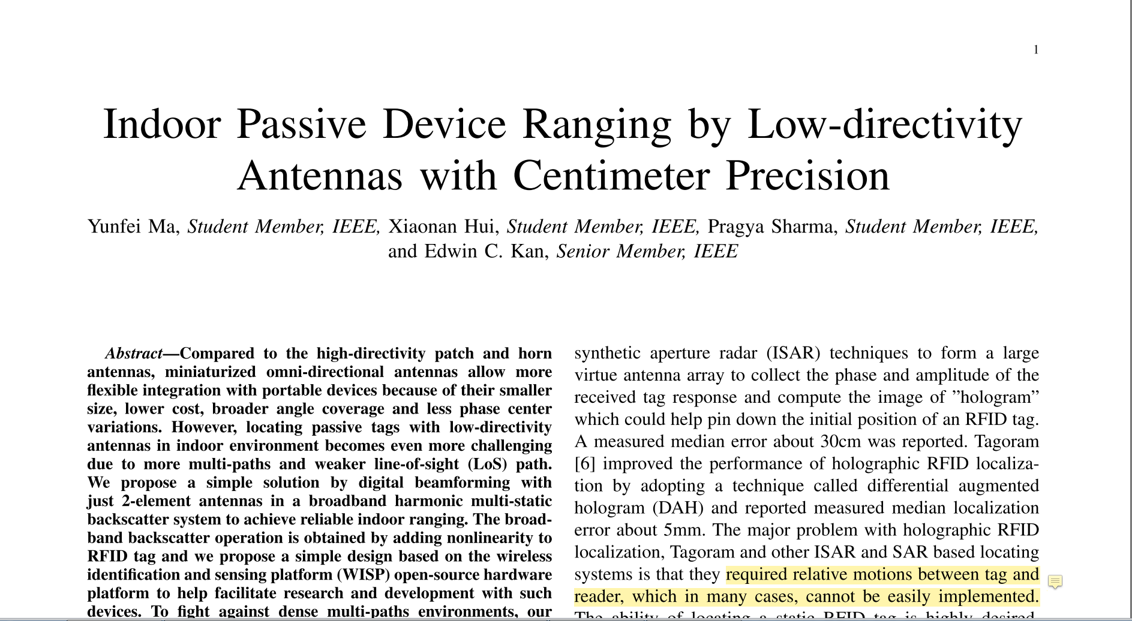



Gather pertinent information

Slide 13
This week
What did/did not work last semester?
GitHub / Blackboard organization
Proposal preparation
What is the plan for working on the proposal? Who does what? How will you coordinate?
What is the scope of the problem for Spring 2018?
What relevant resources have you found?
Brainstorm multiple solutions
Which solutions might be best?

Slide 14
This week
What did/did not work last semester?
GitHub / Blackboard organization
Proposal preparation
What is the plan for working on the proposal? Who does what? How will you coordinate?
What is the scope of the problem for Spring 2018?
What relevant resources have you found?
Brainstorm multiple solutions
Which solutions might be best?

Slide 15
For next week
Project proposal due Monday February 19th!
We will discuss your proposed management plan

